Slide 1


PlumeViz: Interactive Exploration for Multi-Facet Features of Hydrothermal Plumes in Sonar Images
Yiming Shao¹, Chengming Liu¹, Zhiyuan Meng¹, Shufan Qian¹, Peng Jiang¹, Yunhai Wang², Qiong Zeng¹
¹ Shandong University
² Renmin University of China
Notes:
Good morning everyone, I am Yiming Shao from Shandong University, China. It is a great honor for me to present our work on behalf of my team. My presentation title is PlumeViz: Interactive Exploration for Multi-Facet Features of Hydrothermal Plumes in Sonar Images.

Slide 2
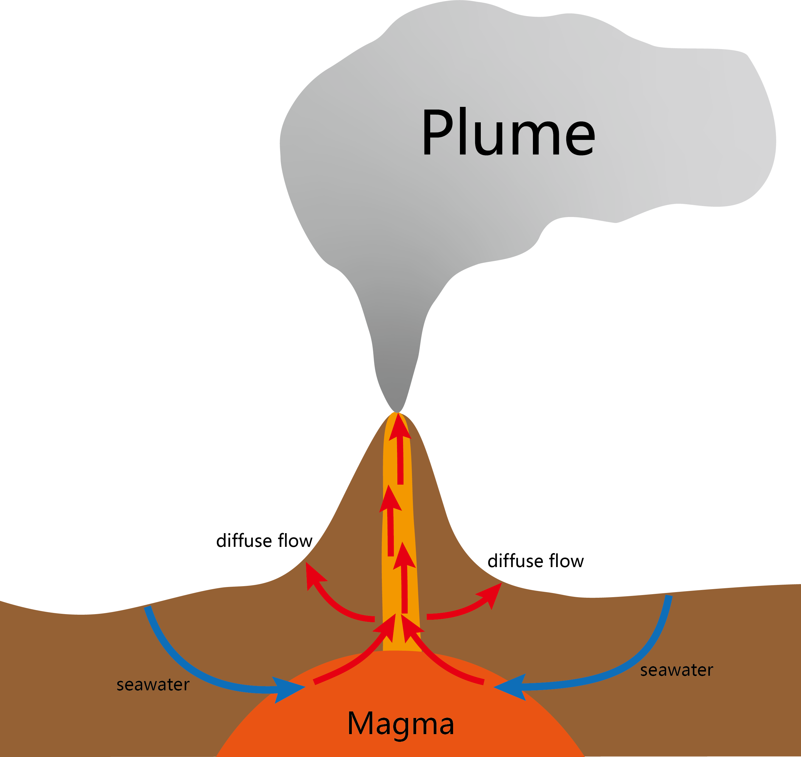
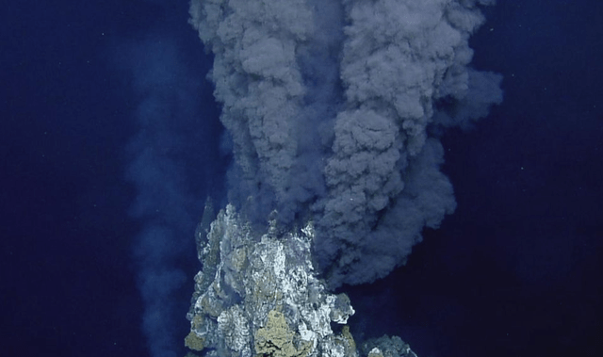
Background
[1] Bemis et al. The path to covis: A review of acoustic imaging of hydrothermal flow regimes. Deep Sea Research Part II: Topical Studies in Oceanography, 2015, 121:159–176.
[2] Rona et al. Acoustic imaging, visualization, and quantification of buoyant hydrothermal plumes in the Ocean. Marine Geophysical Research, 2022, 23(2):147–168.
Notes:
Hydrothermal plumes are a mixture of seawater and hydrothermal fluids, which are generated by the circulation of seawater through the oceanic crust. They serve as essential markers for researchers studying deep-sea hydrothermal systems.

Slide 3
Background
Data (imaging/diffuse/doppler)
Acoustic Device
[1] Bemis et al. The path to covis: A review of acoustic imaging of hydrothermal flow regimes. Deep Sea Research Part II: Topical Studies in Oceanography, 2015, 121:159–176.
[2] Rona et al. Acoustic imaging, visualization, and quantification of buoyant hydrothermal plumes in the Ocean. Marine Geophysical Research, 2022, 23(2):147–168.
Notes:
In recent years, acoustic imaging techniques have been developed to detect hydrothermal discharges, including plume imaging, plume Doppler velocity, and diffuse flow. Visualization techniques play a crucial role in facilitating the analysis of these multi-source and multi-faceted data.

Slide 4
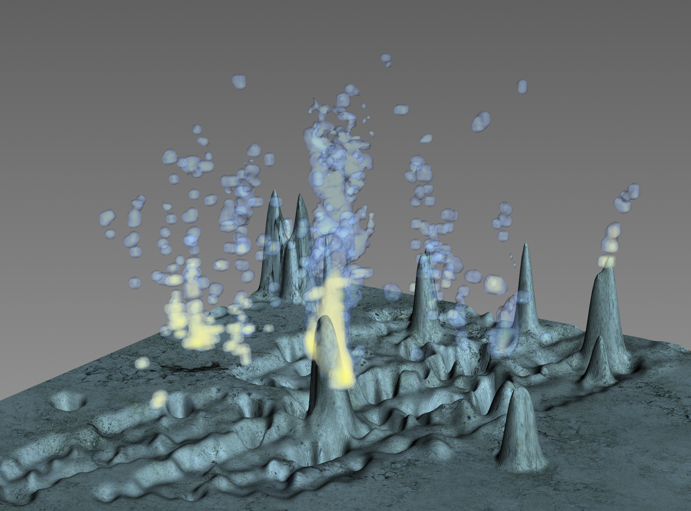
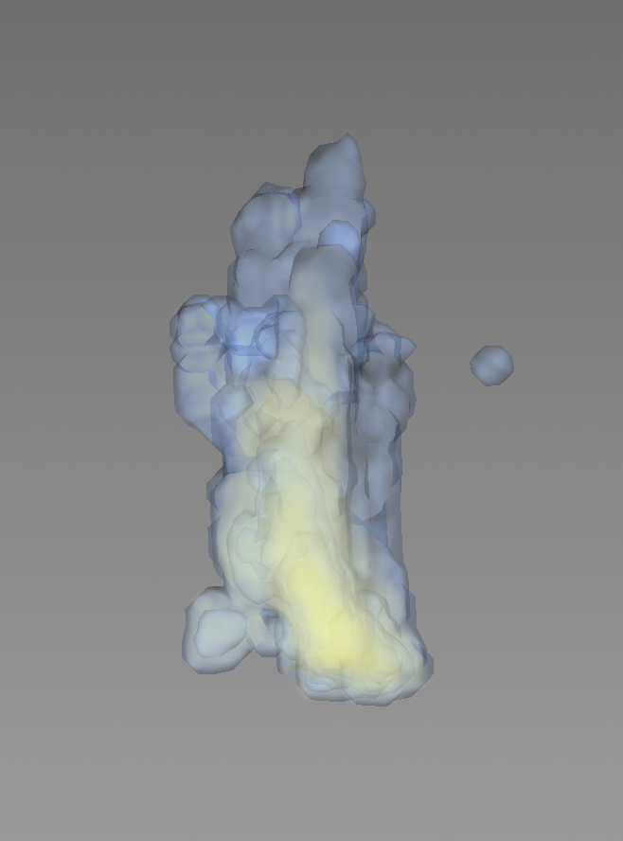
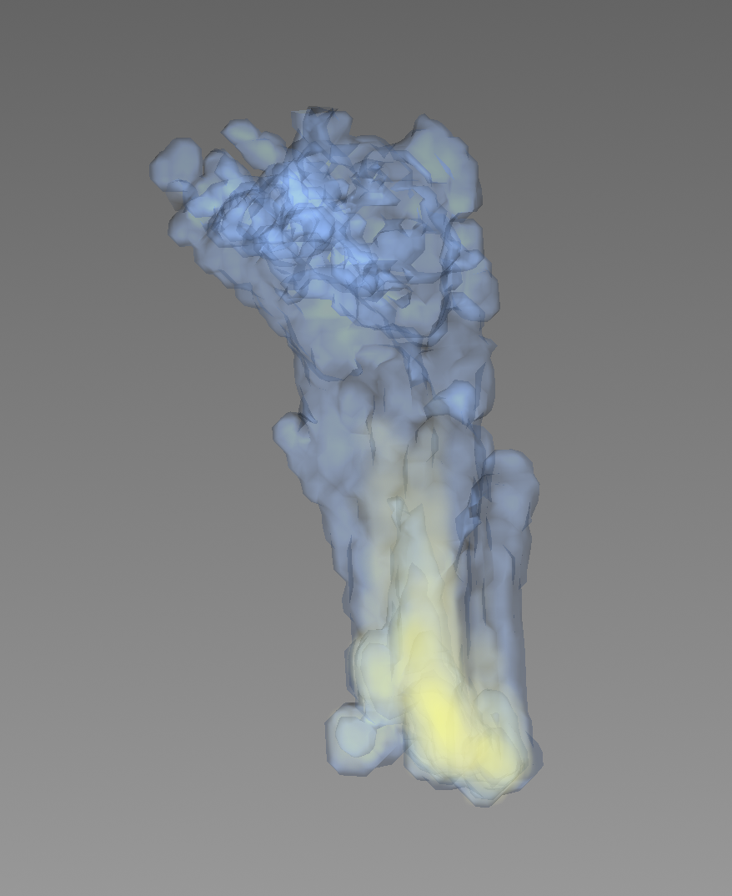
Challenges
Hard to remove noises on plume data
Long time interval between two frames of data
( 2020/08/16 6:00 )
( 2020/08/16 8:00 )
The original data contains too much noise, making it difficult to distinguish the target plume.
The long intervals (2 hours in this example) between data frames make it hard to observe changes in the plume over time.
Notes:
However, visualizing acoustic data from plumes presents several challenges. One major issue is the significant noise in plume data, which is difficult to eliminate. Additionally, the long intervals between data frames make it hard to observe changes in the plume over time.

Slide 5
Framework of PlumeViz
Visualization Phase
Interactive Exploration
Region-of-interest cropping & selection
Visual parameter control
Dynamic sequence control
Preprocessing Phase
Feature Extraction
Data Preprocessing
Plume Location
Centerline
Gradients
Velocity
Heat flux
Data format transfer
Data precalculation
Region segmentation
Data filtering
Notes:
To address these challenges, we have developed an interactive exploration tool,Plumeviz, for visualizing hydrothermal plumes in sonar images. This figure illustrates the framework of PlumeVIz.
We use sonar data that has been preliminarily processed and interpolated into a uniform grid. Then, in the data preprocessing phase, we convert the data into a readable format and perform some precalculations for efficient visualization.
In the visualization phase, we provide an interactive method to locate the plume region and allows users to explore the plume features.

Slide 6
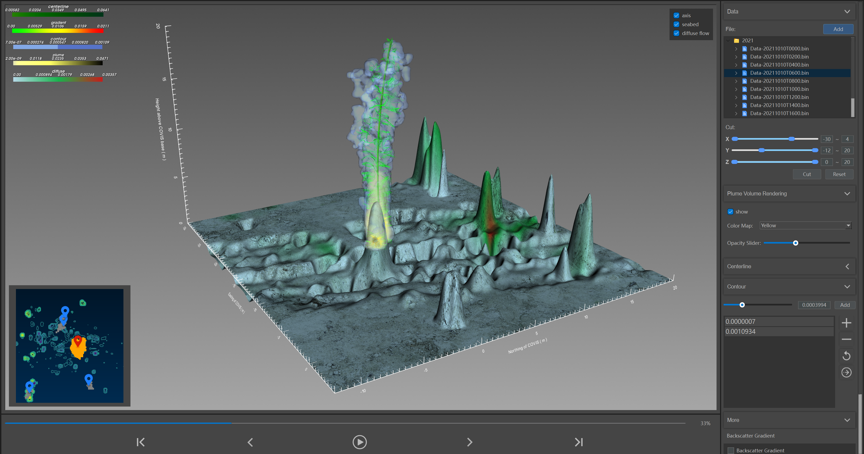
Overview
Notes:
Here shows an overview of PlumeViz. At the center of the screen is the area to display the plume. In this figure, our tool showcases an overview of multi-faceted plume features. These include a 3D plume structure, centerline, and backscattering intensity gradients, in addition to seafloor topography and diffuse flow patterns.

Slide 7
Overview
Region-of-interest Cropping & Selection
Notes:
In the lower left corner, there is a minimap, where users can click icons to select the region of interest.

Slide 8
Overview
Visual
Parameter Control
Notes:
Additionally, users can modify parameters in the right area to adjust the visualization results.

Slide 9
Overview
Plume Visualization
Notes:
At the center of the screen is the plume visualization area, which displays the multi-facet plume visualizations according to user interactions.

Slide 10
Overview
Dynamic Sequence Control
Notes:
We have also provided a dynamic sequence control panel to facilitate the observation of plume changes over time.

Slide 11
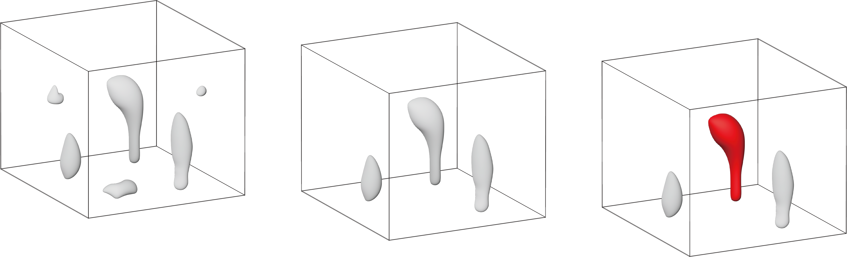
Isolating the Plume
Plume Location
Region Segmentation
Region Filtering
ROI Selection
Notes:
To visualize plumes and their features, the first step is to isolate the plumes from the background. Our approach integrates automatic data filtering methods with user interactions to address the challenges posed by data noise. Specifically, we first apply an extended region-growing algorithm to segment the data into multiple independent regions, allowing us to track the same plume across different timestamps. We then automatically identify the regions containing a certain number of voxels as candidate plumes. Finally, users can freely select and display the regions of interest.

Slide 12
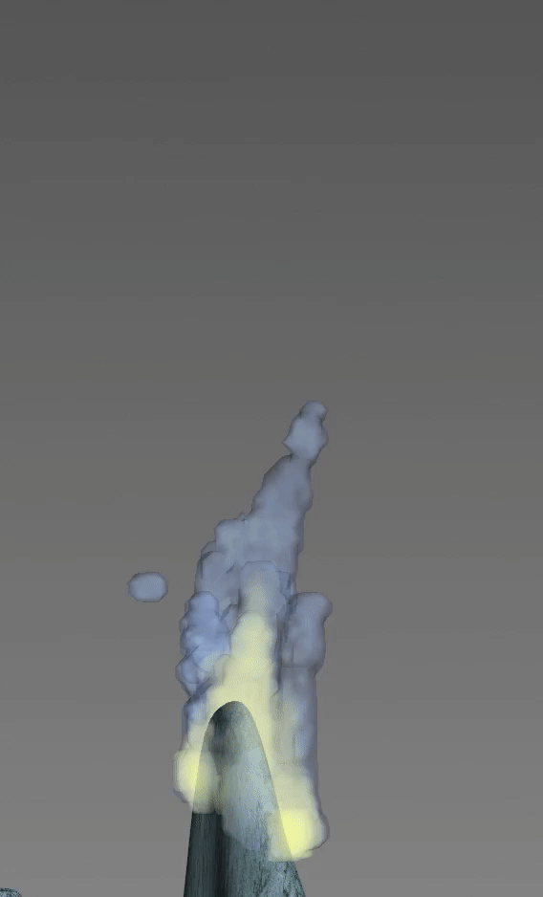
Display the Plume
Plume Location
We use a combination of direct volume rendering and iso-surface extraction to show the plume itself.
To facilitate smooth data evolution, we interpolate data between consecutive time steps using linear interpolation.
Notes:
To display both the internal and contour structures of plumes, we combine direct volume rendering with iso-surface extraction for visualization. To address the issue of long time intervals between plume data points, we apply linear interpolation to create smooth transitions between consecutive time steps, resulting in a more continuous data evolution.

Slide 13
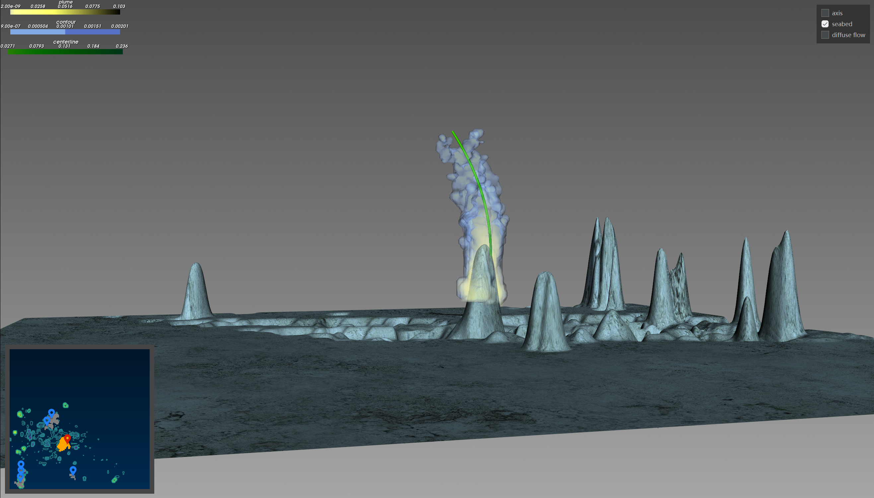
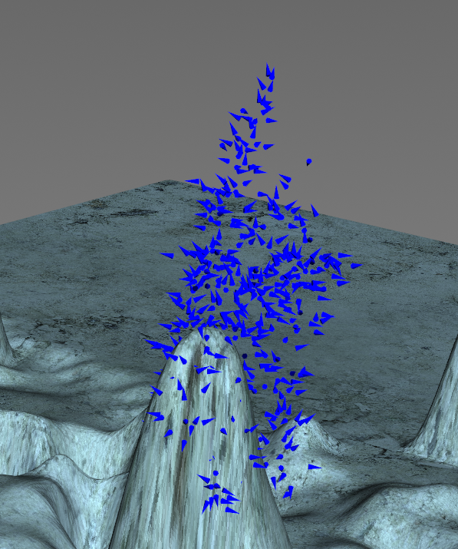
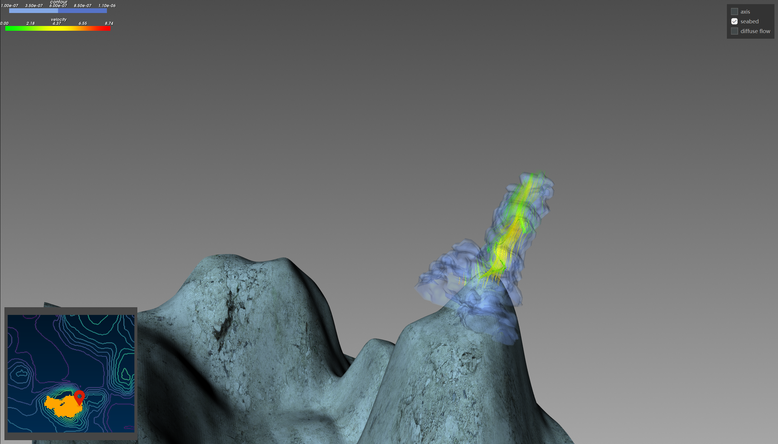
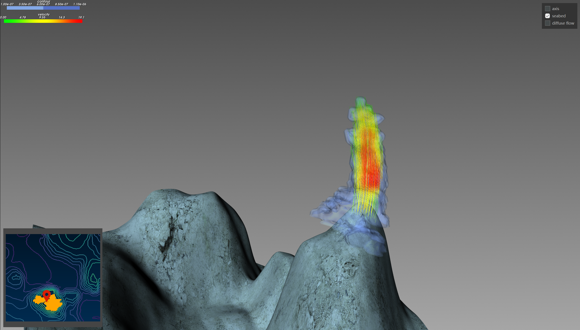
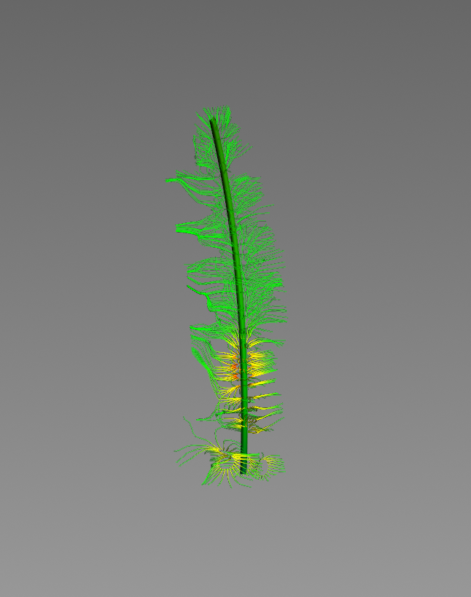
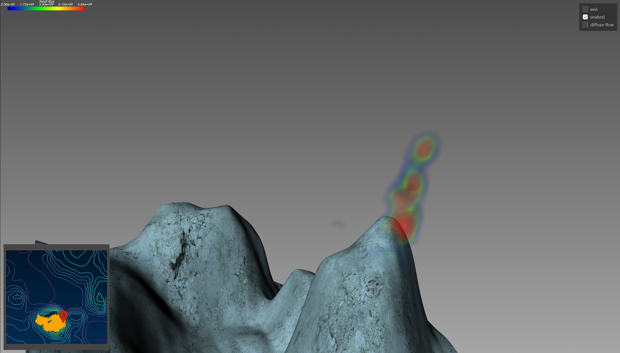
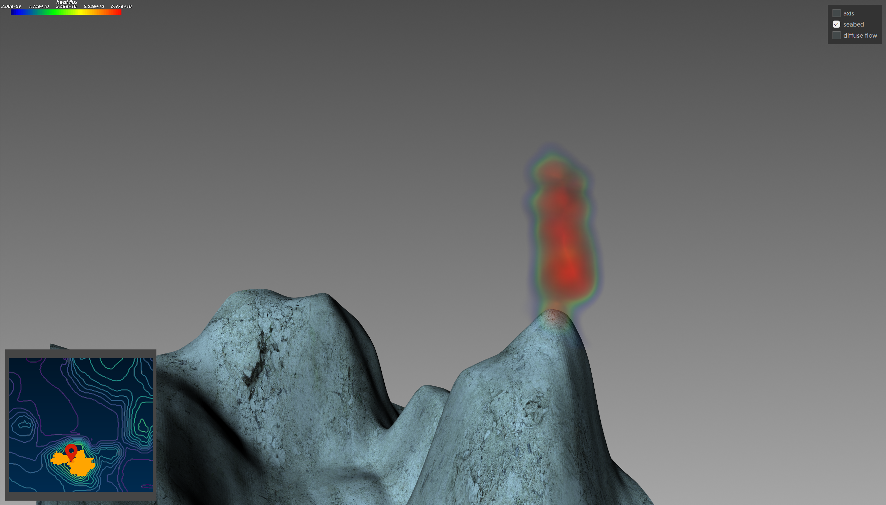
Features Overview
Multi-Facet Plume Feature Extraction
Notes:
Plume features such as centerline and heat flux provide insights for domain expert to better understand plumes’ behavior. So our second aim is to extract multi-faceted plume feature, such as plume centerline, backscattering intensity gradients, plume velocity and heat flux.

Slide 14
Plume Centerline
Multi-Facet Plume Feature Extraction
Notes:
First, we extract the plume centerline.

Slide 15
Plume Centerline
Multi-Facet Plume Feature Extraction
Slice along the z-axis
Find local maximum point in each slice
Curve fitting
Notes:
Specifically, we identify the line connecting points of maximum concentration within each plume cross-section along the z-axis. These connecting points are then fitted with a smooth quadratic polynomial function. After this operation, we obtain a smooth curve representing the centerline of the plume.

Slide 16
Backscattering Intensity Gradients
Multi-Facet Plume Feature Extraction
Notes:
To analyze plume intensity and direction changes, we calculated backscattering intensity gradients using central differences.

Slide 17
Backscattering Intensity Gradients
Multi-Facet Plume Feature Extraction
Gradients can be visualized as:
small arrows (top figure)
streamlines (bottom figure)
Notes:
These gradients can be visualized as either small arrows, or as streamlines.

Slide 18
Doppler Velocity
Multi-Facet Plume Feature Extraction
Notes:
To address the need for research on plume dynamics and energy, we require a comprehensive analysis and visualization of Doppler data. The Doppler data contains the line-of-sight velocity of the plume.

Slide 19
Doppler Velocity
Multi-Facet Plume Feature Extraction
After performing geometric calculations based on existing work, we derive the plume velocity from the doppler data.
Then, we use the fourth-order Runge-Kutta method to calculate streamlines and draw them.
Notes:
After performing some geometric calculations, we can derive the plume velocity from the doppler data. Then, we draw the streamline using the fourth-order Runge-Kutta method.

Slide 20
Heat Flux
Multi-Facet Plume Feature Extraction
Notes:
Heat flux is an important factor in studying dynamic hydrothermal discharges in vertical directions. After obtaining the plume velocity, we can calculate the plume heat flux.

Slide 21
Heat Flux
Multi-Facet Plume Feature Extraction
We use the classic ray casting method to render the calculated heat flux strengths with a rainbow colormap.
Notes:
Then we use the classic ray casting method to render the calculated heat flux with a rainbow colormap and a log-scaled opacity function.

Slide 22
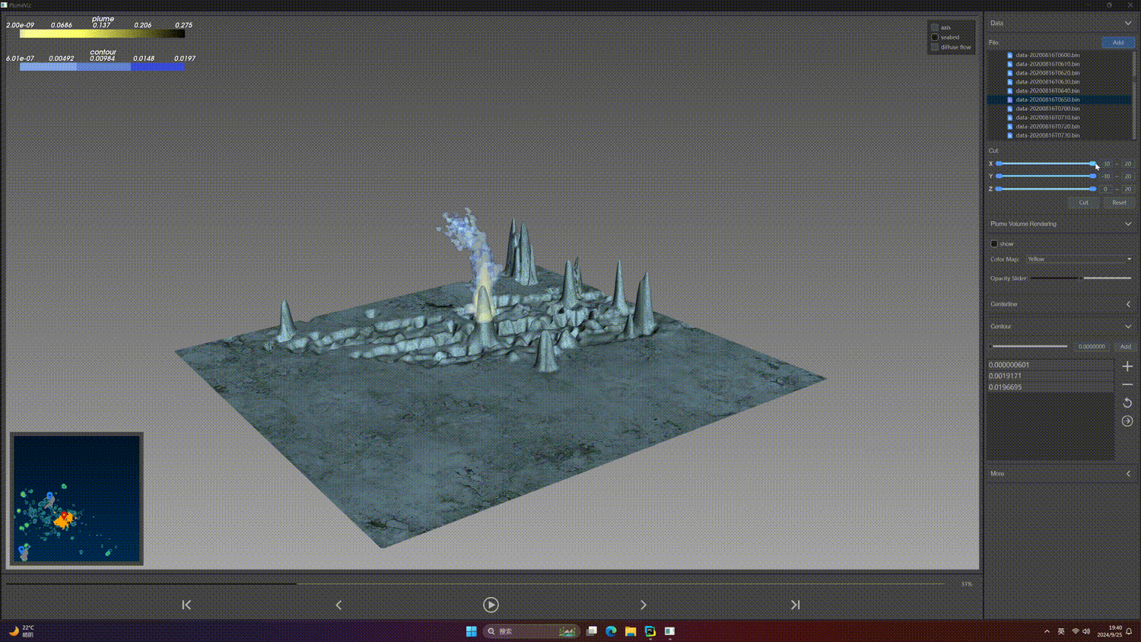
Region-of-Interest Cropping
Interactive Exploration
Notes:
Given the extensive range of plume imaging data and noise present in extracted plume regions, we offer both region cropping and selection tools to facilitate user exploration. The cropping tool enables users to define the area of interest by adjusting axis sliders, with the 3D crop displayed dynamically.

Slide 23
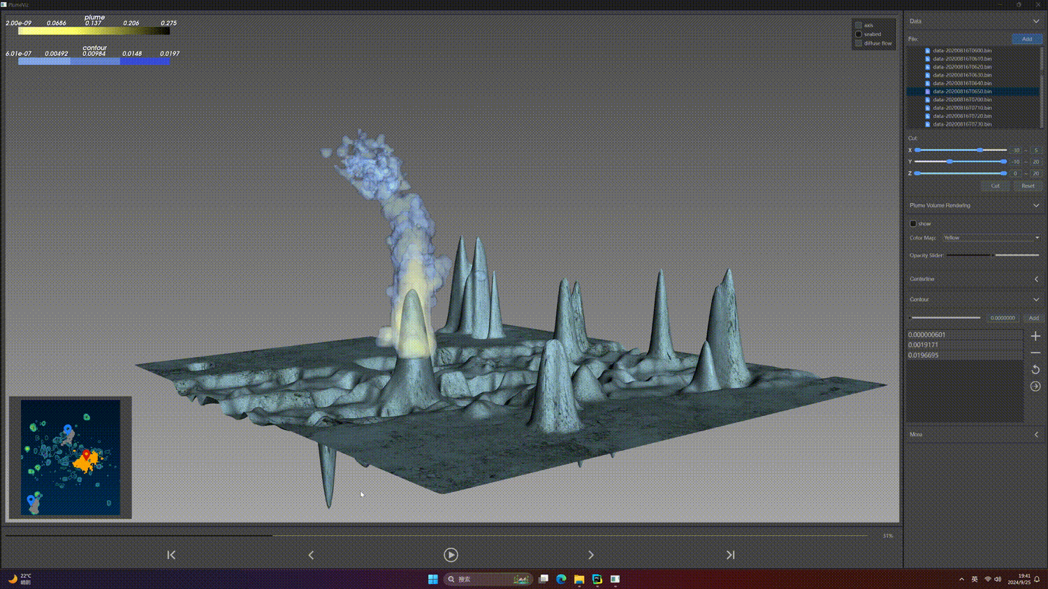
Region-of-Interest Selection
Interactive Exploration
Notes:
For more focused analysis, the region selection tool allows users to pinpoint specific plume regions by clicking on corresponding areas within a 2D minimap.

Slide 24
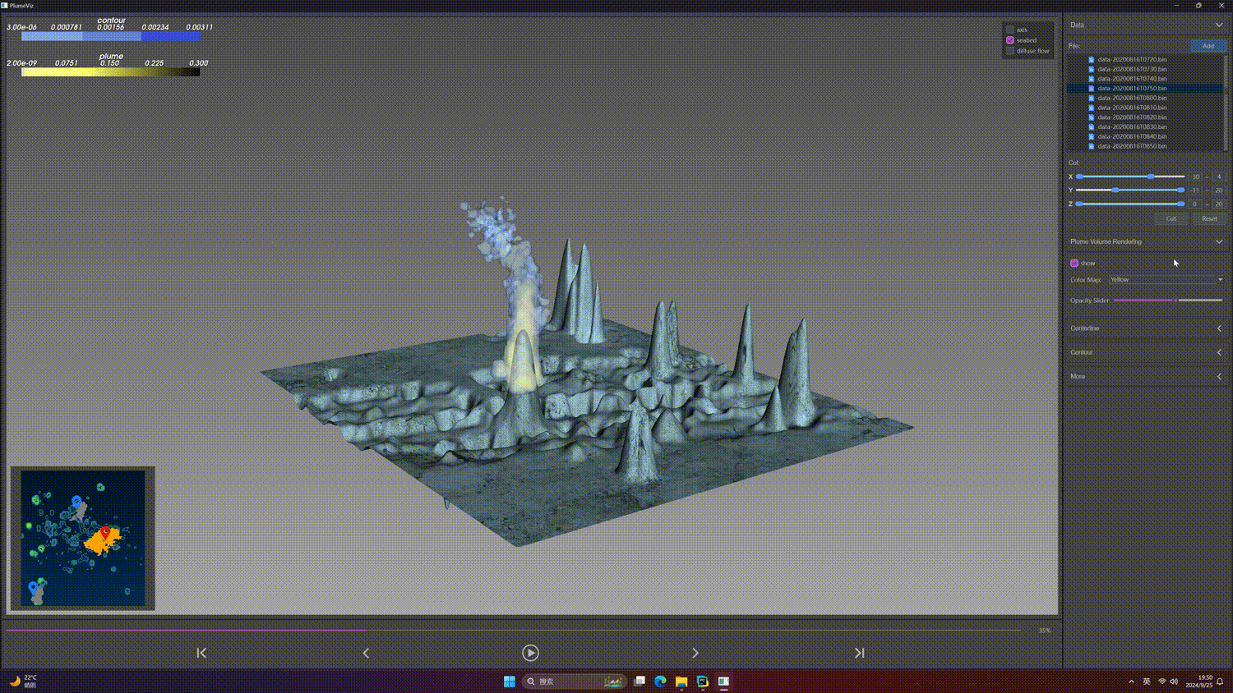
Visual Parameter Control
Interactive Exploration
Notes:
Our tool integrates a diverse range of continuous color maps from Python’s Matplotlib library. Users can choose their preferred color maps, and our tool will automatically adjust the color distribution to align with the data distribution. Additionally, users have the flexibility to modify the opacity function to enhance the visualization of the inner plume structures of interest. We also provide interfaces that allow users to specify values for extracting iso-surfaces from the 3D plume imaging data.

Slide 25
Conclusion
We provide an interactive method, PlumeViz, for plume visualization.
PlumeViz includes three main functionalities, including plume location, multi-facet feature extraction, and interactive explorations.
Our tool empowers users to investigate diverse plume features (e.g., plume bending, structure) and dynamic hydrothermal discharges.
Notes:
In conclusion, we introduced a novel interactive exploration tool, plumeViz, for visualizing dynamic hydrothermal plumes in sonar imaging.
Our results effectively demonstrate plume bending, structure, and temporal changes. Equipped with interactive explorations, our tool provides an interactive method for plume visualization and empowers users to investigate diverse plume features, (including bending direction and degree, backscattering intensity gradients, and dynamic hydrothermal discharges).

Slide 26

Thank you for your attention!
More details and source code can be found on: https://syming123.github.io/plumeviz/
Notes:
More details about our tool and source code can be found on this website. Thank you for your attention.

